Slide 1

STU help

Slide 2

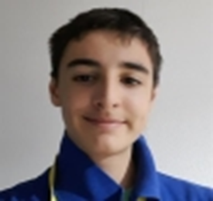
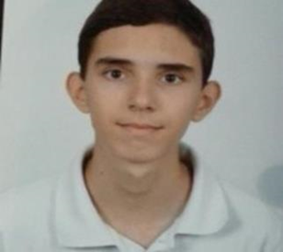
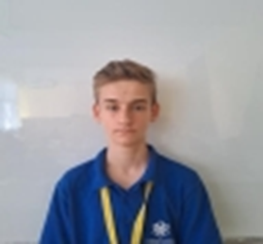
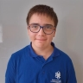
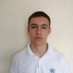
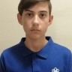
9-th class
TEAM
10-th class

Slide 3

OUR MISSION
Our idea is to help students test their skills after self preparation! For example if you are having an English Exam tomorrow you will need to ready and study and after that you can join our app and test the skills you learned by yourself!

Slide 4


PROCESS
We made a group in teams
Our coders made the app structure
Our team comited the made structure!
We made the documentation
AND NOW we are defending our project!

Slide 5







APPS USED

Slide 6
LETS GO TO THE APP

